Slide 1

Note: The data and information in this document is reflective of a hypothetical situation and client. This document is to be used for KPMG Virtual Internship purposes only.
Sprocket Central Pty Ltd
Data analytics approach
Rutuja Wardole - Junior Consultant

Slide 2
Note: The data and information in this document is reflective of a hypothetical situation and client. This document is to be used for KPMG Virtual Internship purposes only.
Agenda
Introduction
Data Exploration
Model Development
Interpretation

Slide 3
Note: The data and information in this document is reflective of a hypothetical situation and client. This document is to be used for KPMG Virtual Internship purposes only.
Introduction
Identify and recommend top 1000 customers to target from dataset.
Outline of problem:
Sprocket Central is a company that specializes in high quality bikes and cycling accessories.
Their marketing team is looking to boost business sales by analyzing provided datasets.
Using the 3 datasets provided the aim is to analyze and recommend 1000 customers that Sprocket Central should target to drive higher value for the company.
Contents of Data Analysis:
New and Old customer age distribution.
Bike related purchases based on industry.
RFM Segmentation.
Cars owned in each state.
Mass customer Age Distribution

Slide 4
Note: The data and information in this document is reflective of a hypothetical situation and client. This document is to be used for KPMG Virtual Internship purposes only.
Data Exploration
Data Quality Assessment
 | Accuracy | Completeness | Consistency | Currency | Relevancy | Validity
Customer Demographic | DOB :Inaccurate | Job title:null/Blanks Customer ID :Incomplete | Gender:”U” unspecified | Deceased Customer: Removed “yes” | Default Column:Deleted
Customer Address |  | Customer ID:Incomplete | States: Inconsistent names
Transactions | Profit:Missing | Customer ID:Incomplete Online order: null/Blanks Brands:Blanks |  |  | Cancelled Status: Filtered out | List Price: format Product sold date:Changed format

Slide 5
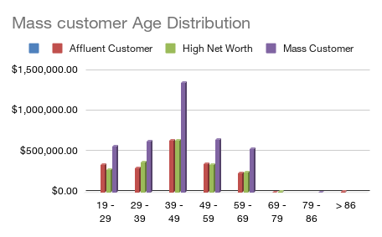
Note: The data and information in this document is reflective of a hypothetical situation and client. This document is to be used for KPMG Virtual Internship purposes only.
Data Exploration
Profit of Wealth Segment by Age Cluster
This data shows that the maximum profit is obtained by the “Mass Customer Segmentation”.
The age cluster shows us the highest distribution.
Mass Customer Aged between 39 – 49 are more likely to bring profit for the company.

Slide 6
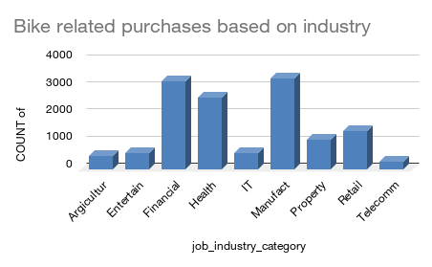
Note: The data and information in this document is reflective of a hypothetical situation and client. This document is to be used for KPMG Virtual Internship purposes only.
Data Exploration
Bike related purchase based on top Job Industry contributing to maximum profit.
This data shows us that the highest contributing job industries are:
Financial Services
Health
Manufacturing
The main reason behind this could be that these industry sectors are based within the city or on the outskirts of the city, hence they prefer bikes.

Slide 7
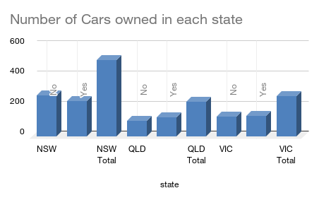
Note: The data and information in this document is reflective of a hypothetical situation and client. This document is to be used for KPMG Virtual Internship purposes only.
Data Exploration
Number of Cars owned based on State.
This data shows us that these states i.e NSW,QLD,VIC could be potential market for the company to make profit.
From this we can see that NSW has the highest number of people who own a car. But the number is almost equal to people who do not own a car, which will eventually give the company an opportunity to find customers here.

Slide 8
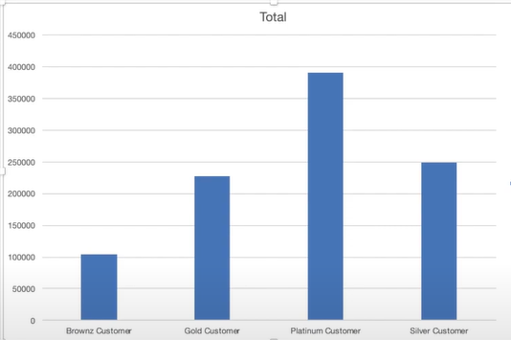
Note: The data and information in this document is reflective of a hypothetical situation and client. This document is to be used for KPMG Virtual Internship purposes only.
Data Exploration
RFM Segmentation (Recency, Frequency, Monetary)
RFM analysis is used to determine which customers should be targeted by a business to increase its profit, revenue and value.
The RFM model shows customers that have high level of engagement with the business in 3 different categories i.e
Platinum: Highest
Gold: Average
Silver: Medium
Bronze: Low

Slide 9
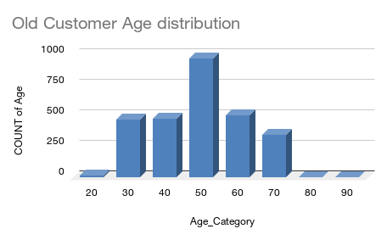
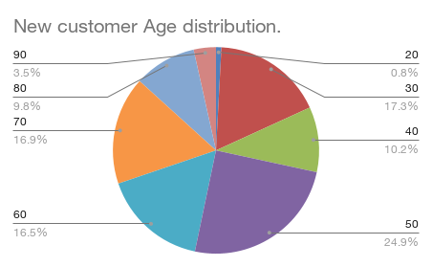
Note: The data and information in this document is reflective of a hypothetical situation and client. This document is to be used for KPMG Virtual Internship purposes only.
Data Exploration
New and Old customer Age distribution.
The “Old” customer graph suggests age between 30 to 70, with 50 showing maximum usage.
The “New” customer graph suggests age between 20 - 30 and 40 – 85+ are most populated.
The lowest age group are under 20 and 90+ for both the groups.

Slide 10
Note: The data and information in this document is reflective of a hypothetical situation and client. This document is to be used for KPMG Virtual Internship purposes only.
Model Development
Targeting High Value Customers - Classification
The following customers should be targeted in order to gain maximum profit.
Customers working in the financial services, health and manufacturing industry.
Aged between 39 to 49.
Living in NSW and VIC.
Female customers will give more high value compared to male customers.

Slide 11
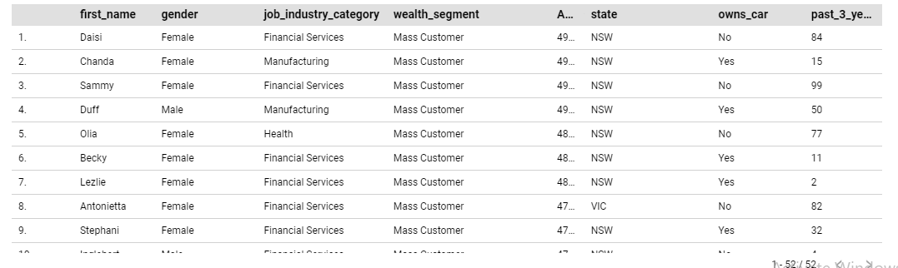
Note: The data and information in this document is reflective of a hypothetical situation and client. This document is to be used for KPMG Virtual Internship purposes only.
Interpretation
High Value Customers Summary Table.

Slide 12
Note: The data and information in this document is reflective of a hypothetical situation and client. This document is to be used for KPMG Virtual Internship purposes only.
THANK YOU!

